Slide 1

The Effects of Distance on College Admission Emails
Michael Gillis
MATH 2113 Statistics with R
Final Project

Slide 2
Introduction

Slide 3
Background
For two years, I received thousands of emails from hundreds of different colleges across the country.
While some sent me many emails consistently, others sent them in small bursts, or only a few at all.
What factors lead to receiving an email from a college?

Slide 4
Background (Cont.)
Many different characteristics can be used to categorize colleges.
Distance from the student’s hometown, endowment, enrollment size, etc.
I hypothesized that distance would be the most impactful characteristic when determining the number of emails a student receives from that college.
Central Research Question: Is the distance of a college from a student’s hometown associated with the number of emails the student receives from that college? (Negative correlation)

Slide 5
Methods
Data Source, Variables, Analysis

Slide 6
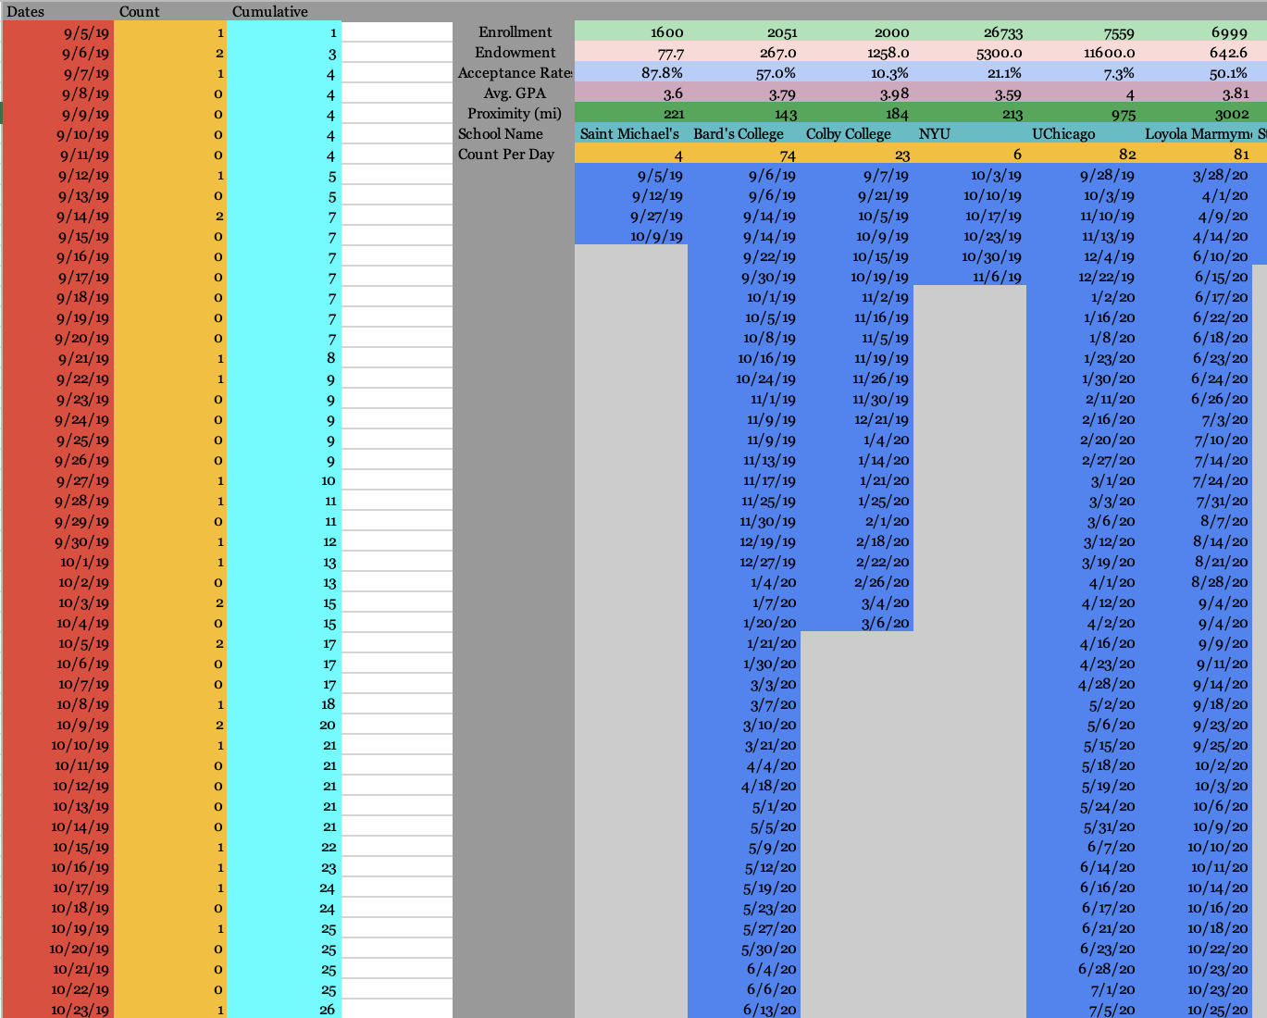
Data Source
To track this data, I recorded every email that was sent to me by a college from September 2019 to September 2021. (Junior and Senior years of high school)
At first, I only recorded the college name and the date of the email.
Later, I added different characteristics to each college, taking the data from the U.S. News and World Report database.

Slide 7
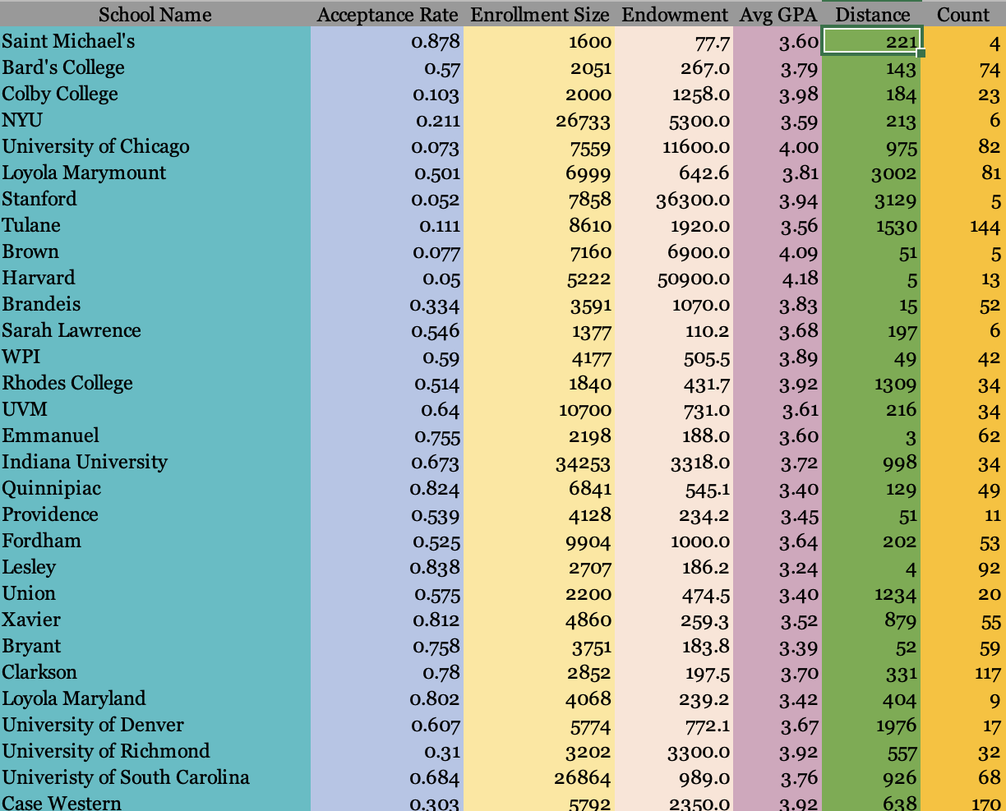
Variables
In order to perform this statistical analysis, I had to clean up this data that I had collected and define all my variables.
Variables:
College Name (ID)
Count per College
Distance
Average GPA (4.0 Scale)
Acceptance Rate (%)
Enrollment Size
Endowment (mil. $)

Slide 8
Statistical Analysis
All of the variables except for the identifier were quantitative, and some were skewed, so I reported the median and Q1, Q3 (interquartile range), in a table for their summary stats.
I used a simple linear regression model to analyze the association between distance and count (p < 0.05), and then to find any insignificant variables to exclude from my multivariable model (p > .10)
I then used a multivariable linear regression model to analyze the relationship between distance and count, while controlling for other significant predictor variables.
I ran one-tailed tests, so the p-values I got from R were divided by 2.

Slide 9
Results
Summary Stats, Simple Model Results, Multivariable Model Results

Slide 10
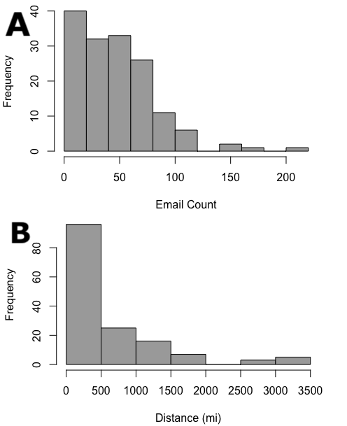
Summary Statistics
152 different colleges from across the U.S. sent a total of 7294 emails throughout the 2 years (n=152).
Count has a median of 42 emails with an IQR of 18 to 65.
Distance has a median of 312 miles with an IQR of 137.5 to 921.5.
The distributions of these variables (see histograms) are heavily skewed, so I used the Student’s t-distribution to analyze the data.
Because I’m using linear regression, and n=152, I’m using 152-2=150 degrees of freedom in the model.

Slide 11
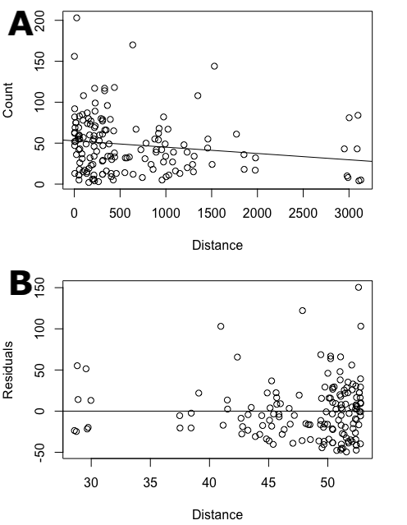
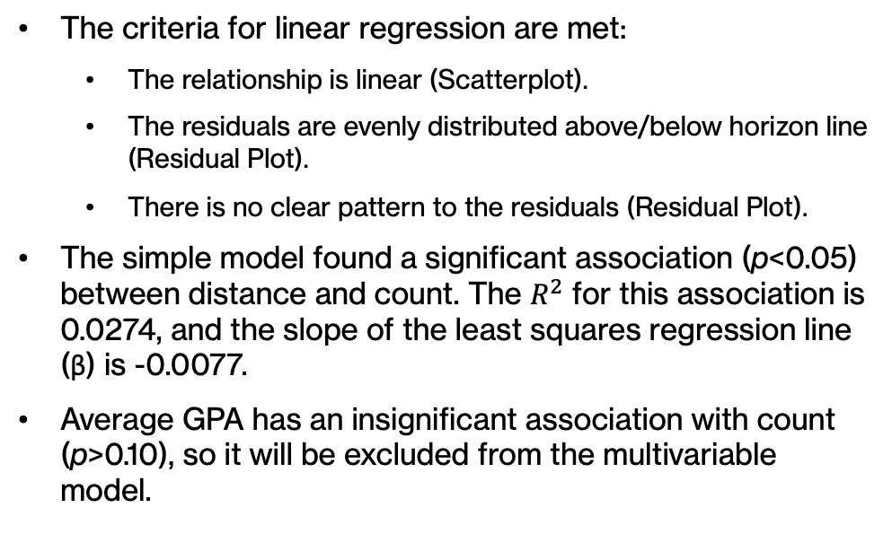
Simple Linear Regression Model
The criteria for linear regression are met:
The relationship is linear (Scatterplot).
The residuals are evenly distributed above/below horizon line (Residual Plot).
There is no clear pattern to the residuals (Residual Plot).
The simple model found a significant association (p<0.05) between distance and count. The $R^{2}$ for this association is 0.0274, and the slope of the least squares regression line (β) is -0.0077.
Average GPA has an insignificant association with count (p>0.10), so it will be excluded from the multivariable model.

Slide 12
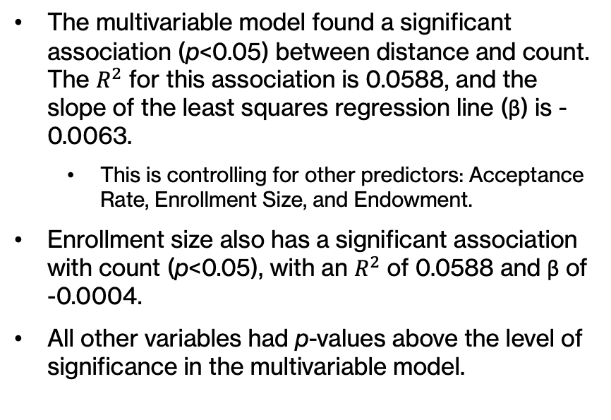
Multivariable Linear Regression Model
The multivariable model found a significant association (p<0.05) between distance and count. The $R^{2}$ for this association is 0.0588, and the slope of the least squares regression line (β) is -0.0063.
This is controlling for other predictors: Acceptance Rate, Enrollment Size, and Endowment.
Enrollment size also has a significant association with count (p<0.05), with an $R^{2}$ of 0.0588 and β of -0.0004.
All other variables had p-values above the level of significance in the multivariable model.

Slide 13
Discussion

Slide 14
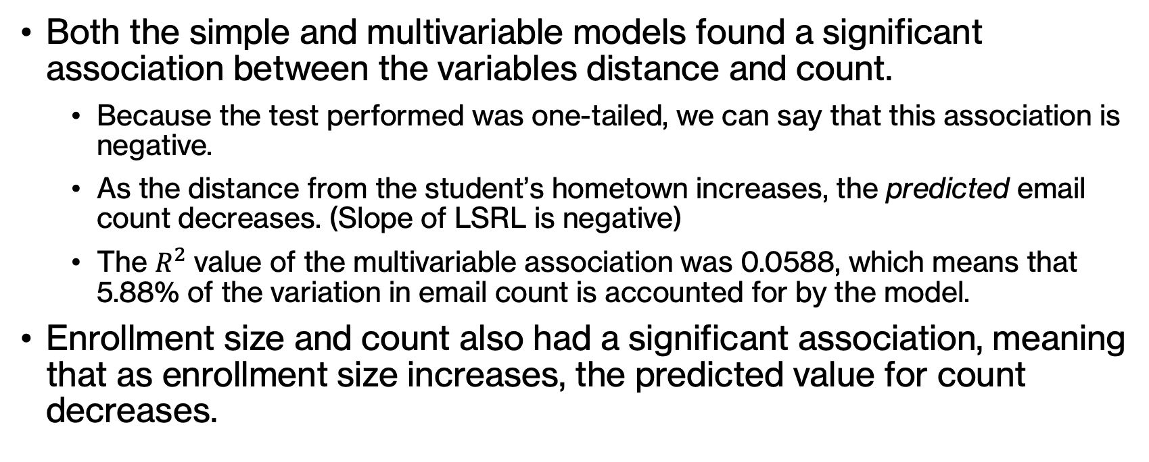
Interpretation of Results
Both the simple and multivariable models found a significant association between the variables distance and count.
Because the test performed was one-tailed, we can say that this association is negative.
As the distance from the student’s hometown increases, the predicted email count decreases. (Slope of LSRL is negative)
The $R^{2}$ value of the multivariable association was 0.0588, which means that 5.88% of the variation in email count is accounted for by the model.
Enrollment size and count also had a significant association, meaning that as enrollment size increases, the predicted value for count decreases.

Slide 15
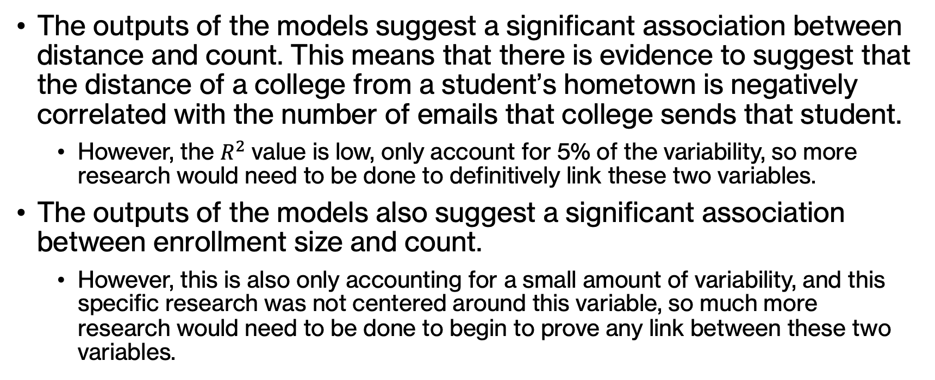
Application to Research Question
The outputs of the models suggest a significant association between distance and count. This means that there is evidence to suggest that the distance of a college from a student’s hometown is negatively correlated with the number of emails that college sends that student.
However, the $R^{2}$ value is low, only account for 5% of the variability, so more research would need to be done to definitively link these two variables.
The outputs of the models also suggest a significant association between enrollment size and count.
However, this is also only accounting for a small amount of variability, and this specific research was not centered around this variable, so much more research would need to be done to begin to prove any link between these two variables.

